Slide 1


College Management Software
BY TEAM CODEOVERLOAD
October 30, 2021

Slide 2
App
Goals
CMS
Signup
Login
Lost & Found
Notification feed
Canteen
Report problems
Attendence Record
Contact Searching
User Page

Slide 3


Technologies
Used
Android Studio
XAMPP (pHp, MySQL)

Slide 4
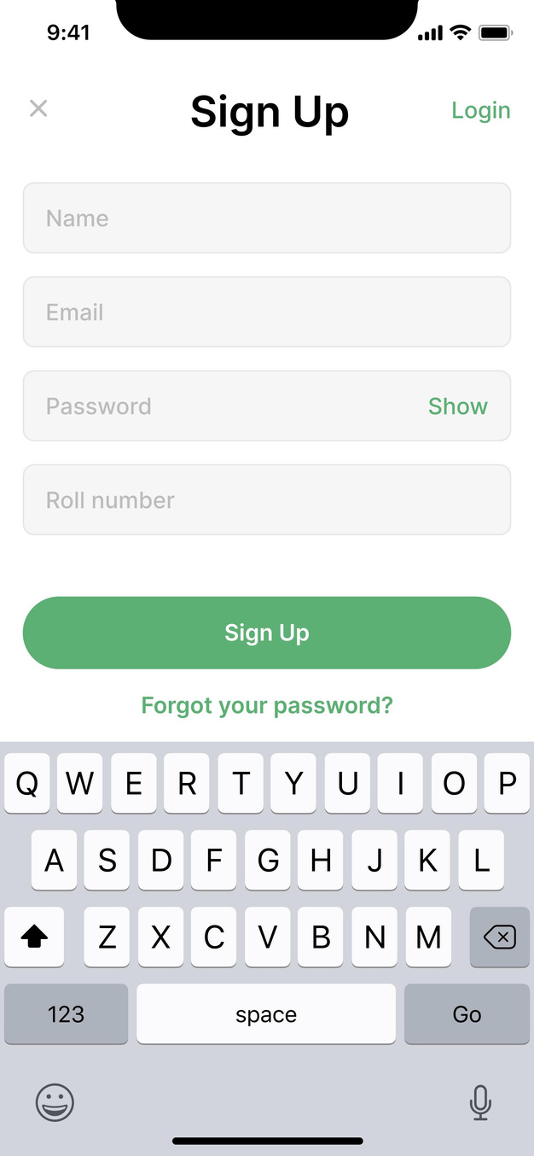
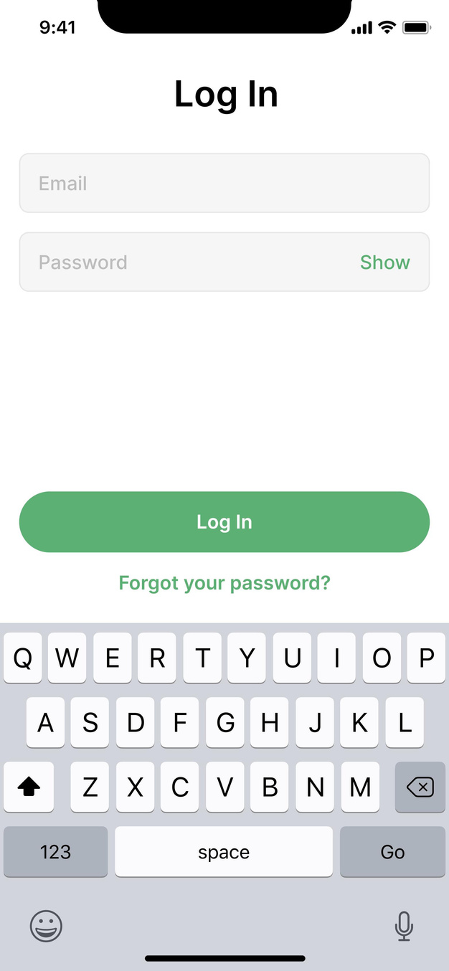

Slide 5
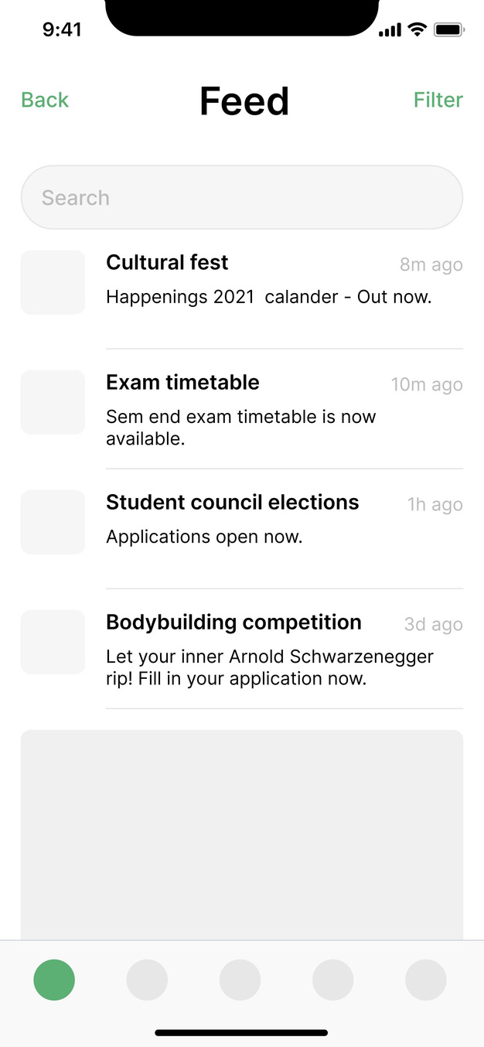
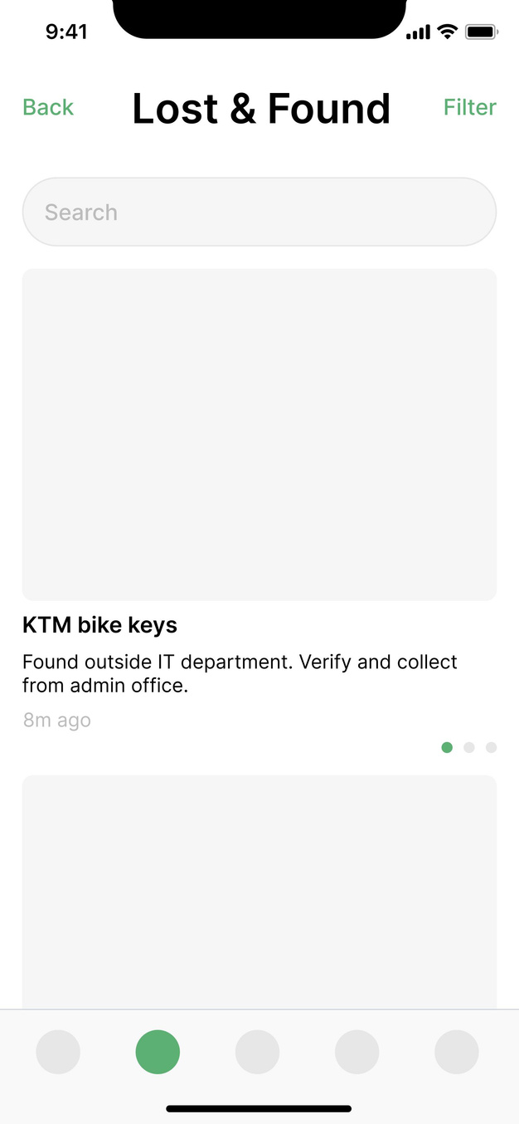

Slide 6
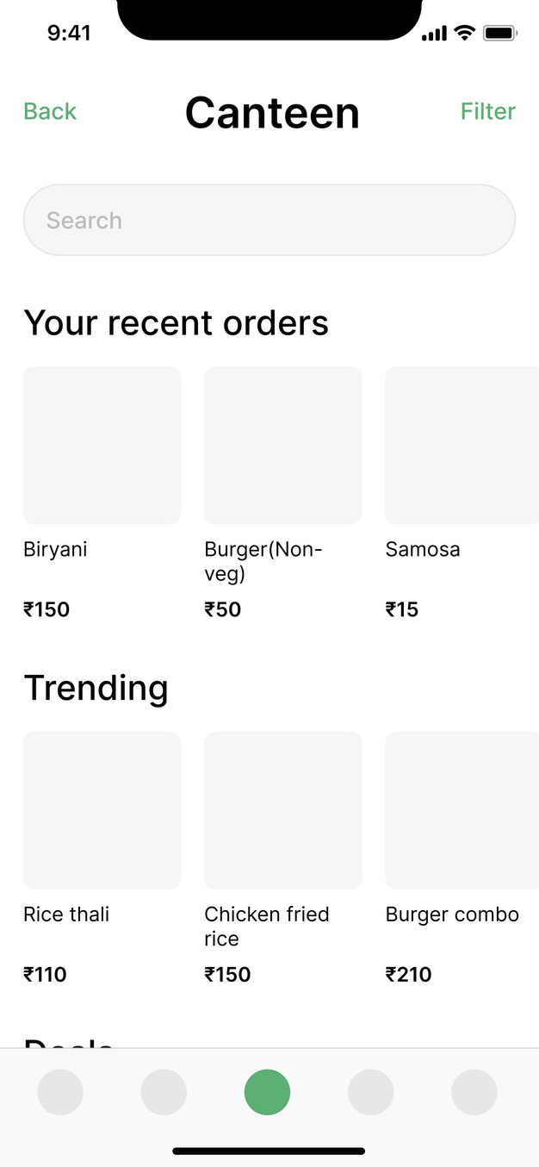
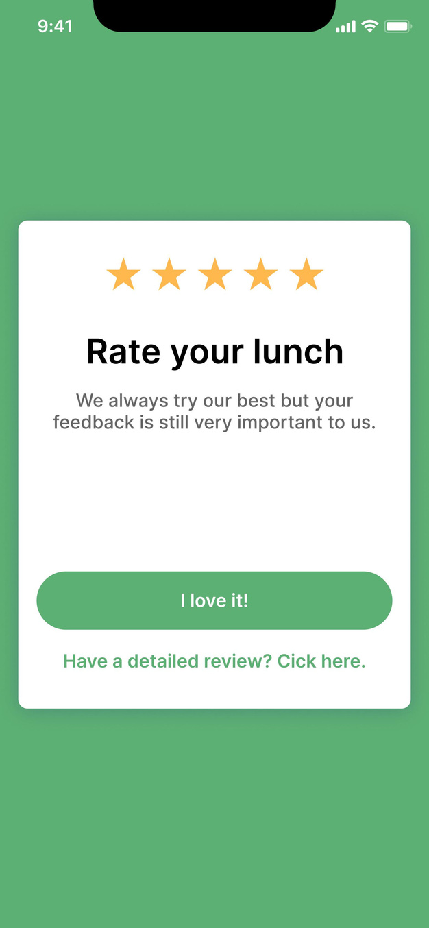

Slide 7
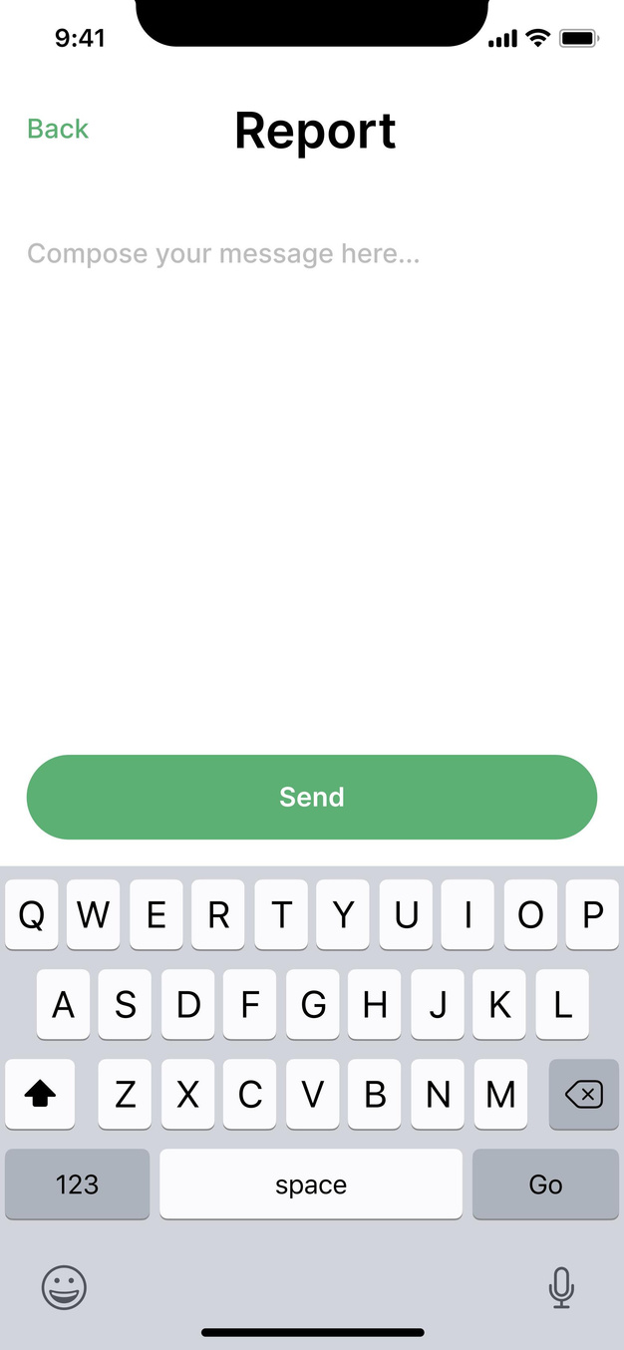
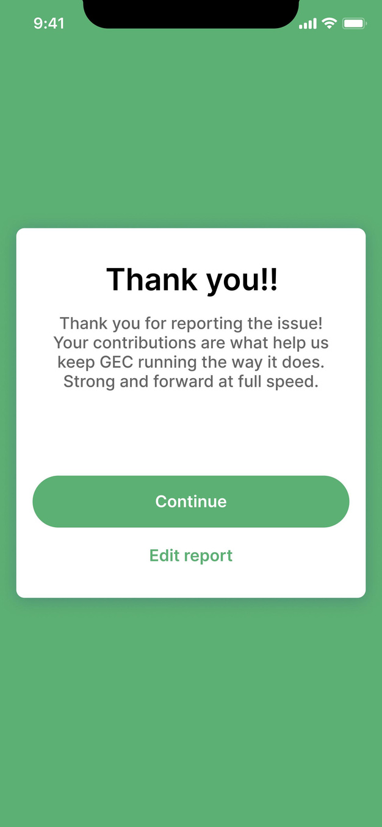

Slide 8
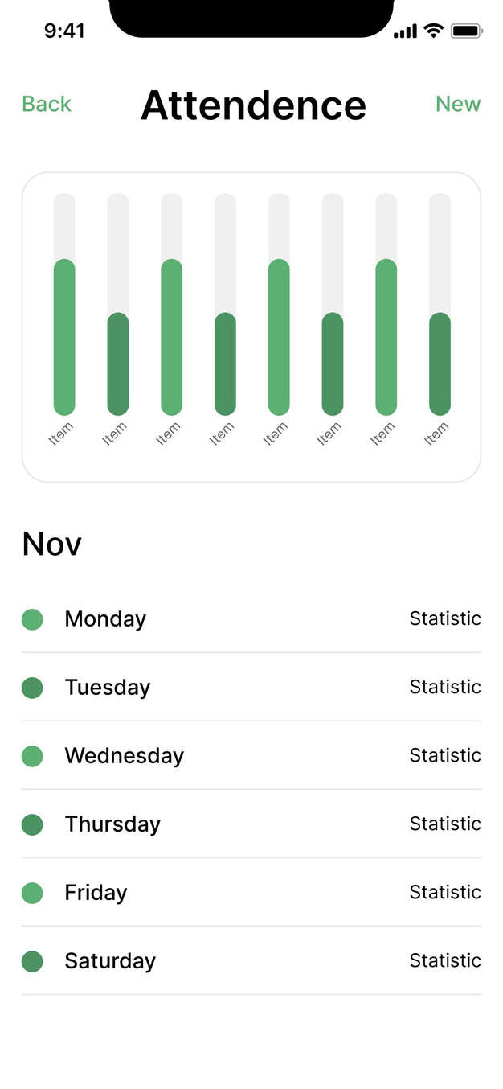
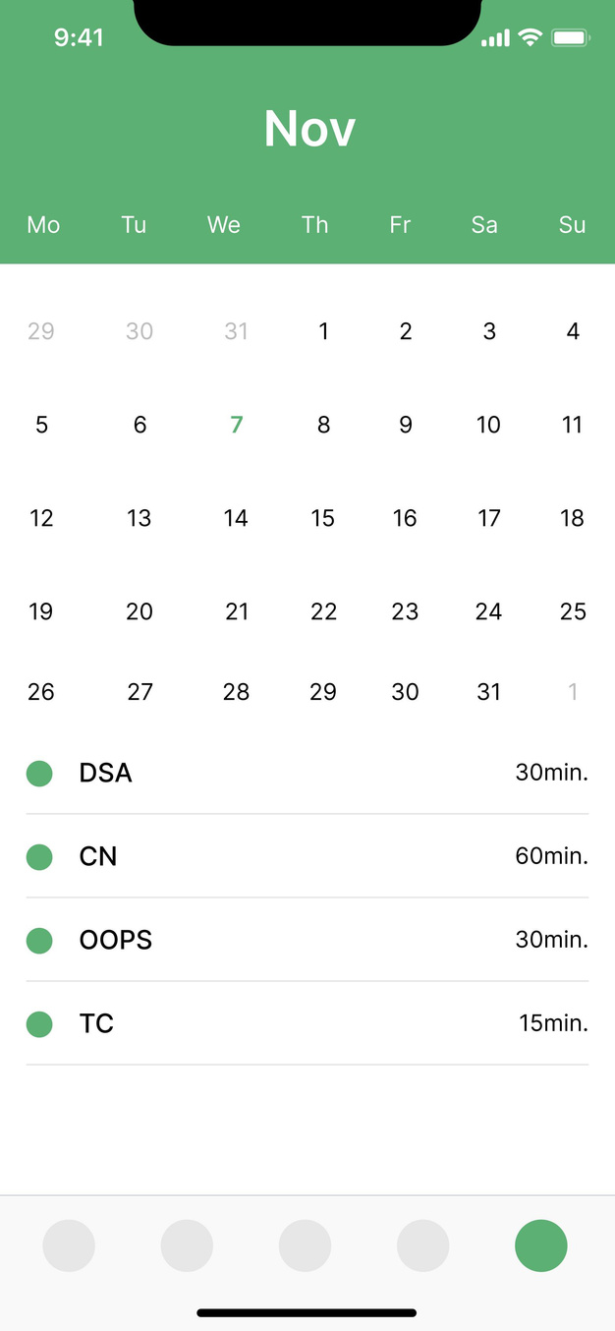

Slide 9
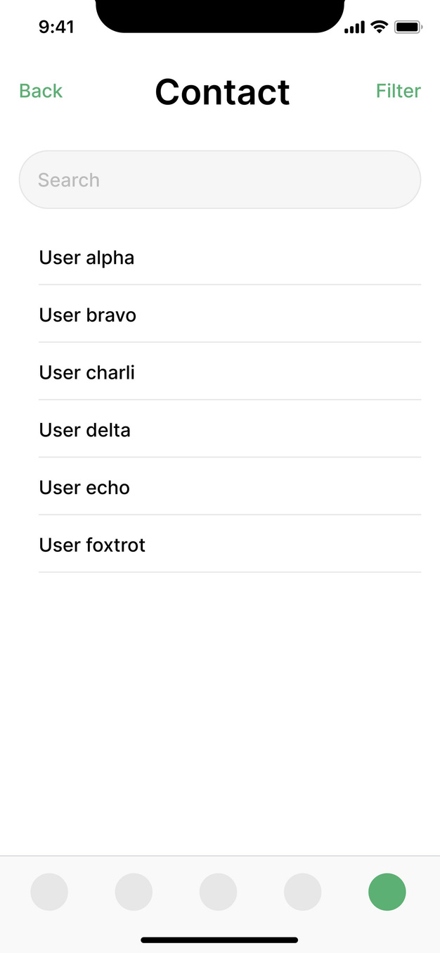
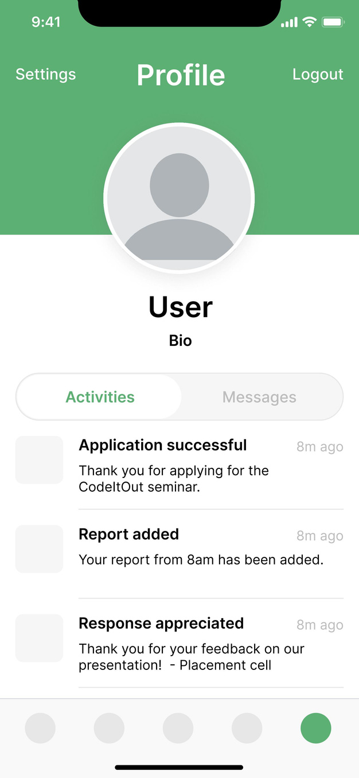

Slide 10
What went wrong?
TRACING THE FAULTS

Slide 11
LACK OF ACTION PLAN
CHAOTIC IMPLIMENTATION
ERROR HUNT
POOR BACKGROUND
RESEARCH
NOT KNOWING THE CODE

Slide 12
THE TAKEAWAYS
PLAN YOUR ATTACK
WORK WITH EACH OTHER
STRATIGISE
PRACTICE
PRACTICE
PRACTICE

Slide 13
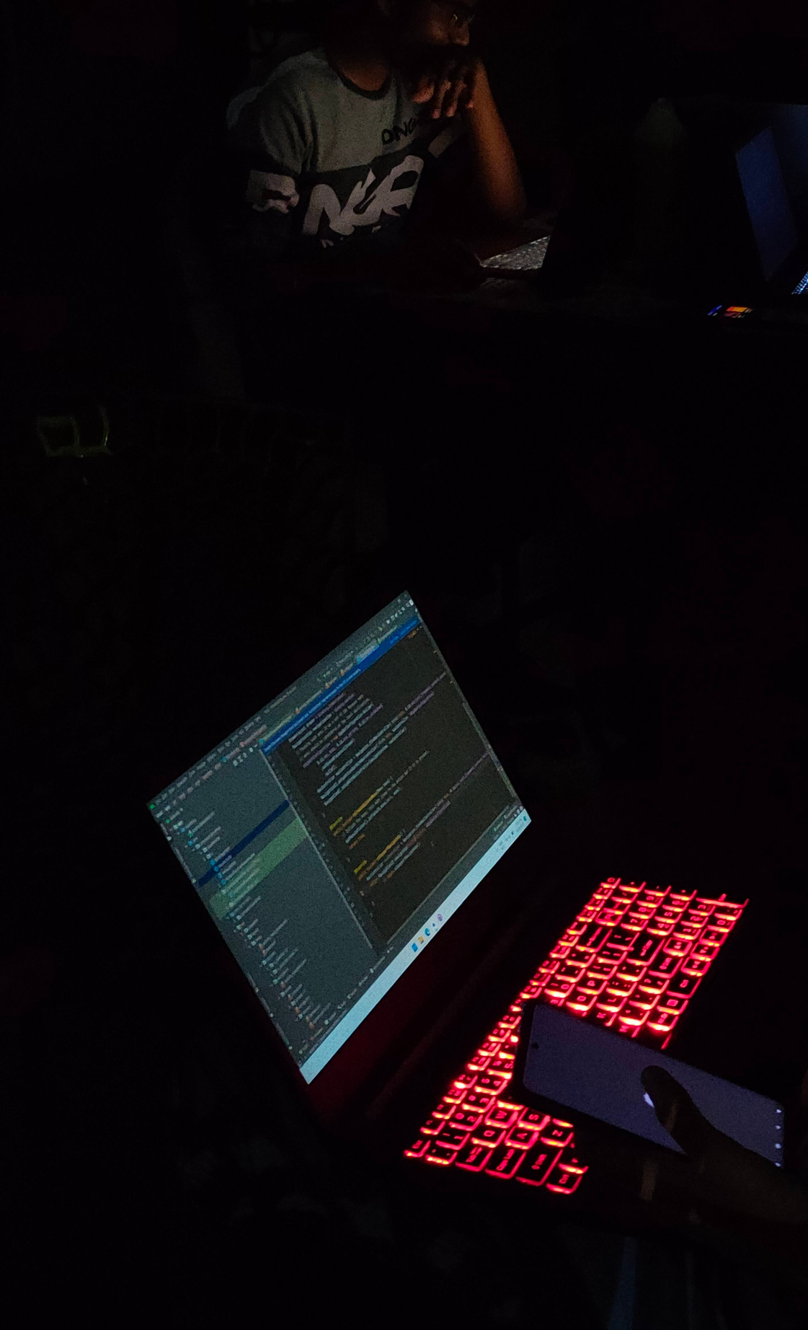
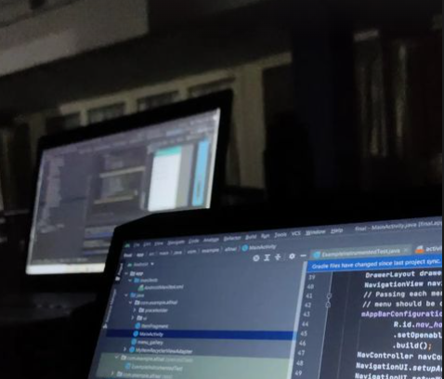
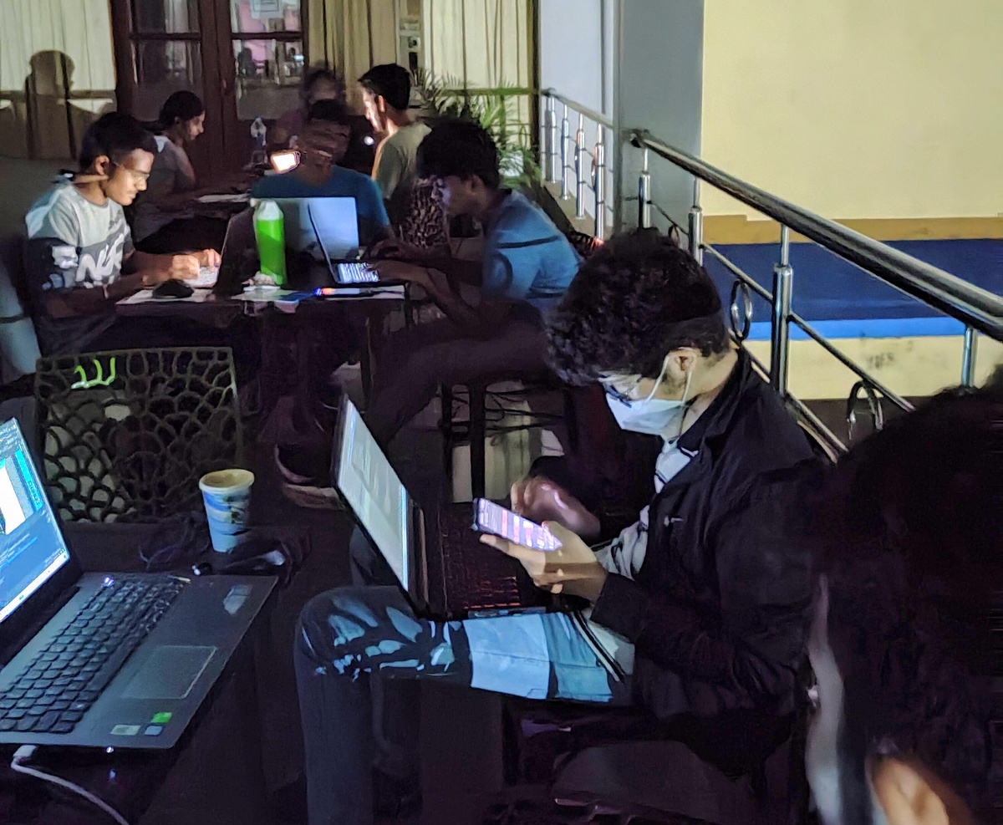
THANK YOU!
WE'LL BE BACK NEXT YEAR, BETTER PREPARED & AS DRIVEN AS EVER
TEAM CODEOVERLOAD

